Slide 1
Sprayer Calibration Workshop
Why Calibrate??
What is the function of a Spray Nozzle
Nozzle Selection Example – AirBlast
Field Calibration

Slide 2
Why Calibrate?
It is estimated that 60% of sprayers have a calibration error greater than + or - 10 %.
43% of sprayers have greater than + or - 10% variation in discharge from individual nozzles.
32% have inaccurate travel speed.
27% have improper boom height for the nozzle spacing and nozzle discharge angle.
13% have inaccurate pressure gauges. Many of the gauges indicate too low pressure.
8% have inadequate hose size to supply nozzles, causing pressure to drop in the system.

Slide 3
Improve Spray Deposition
The purpose of the airflow created by the fan is to displace air in the canopy with pesticide-laden air from the sprayer
Air transports the droplets into the target
Airflow shakes the canopy to aid penetration
Excessive air may blow away droplets already on the target leaves
Excessive airflow results in transporting droplets past the target
Excessive airflow leads to excessive shaking or shingling of the leaves

Slide 4
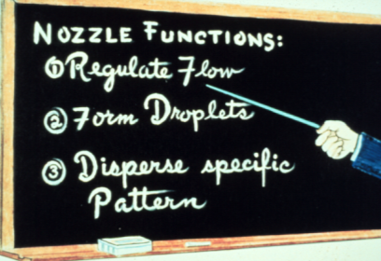
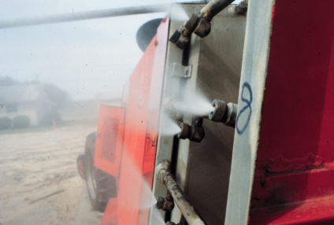
Spray Nozzles
Meter liquid
Size
Atomize (droplet size)
Type (Hollow, Solid Cone or Fan)

Slide 5
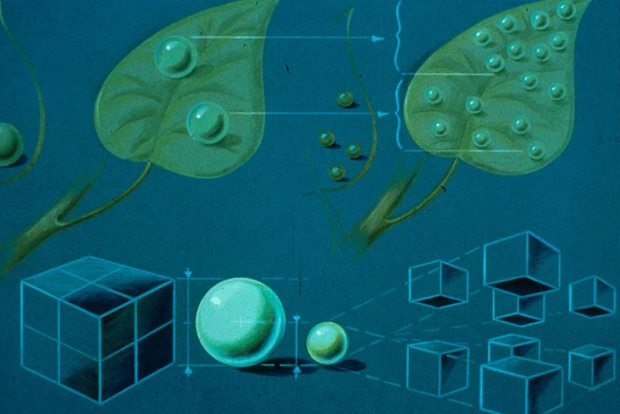
1/2x Droplet diameter = 8x Number of droplets

Slide 6
Improve Spray Deposition
Fit deflectors onto the top of the sprayer to direct air into the canopy
Fit deflectors onto the bottom of the sprayer to direct air up into the canopy
Reduce airflow by reducing fan speed
Research results show a medium fan speed deposits pesticides as well as a high fan speed but also reduces off-target drift

Slide 7
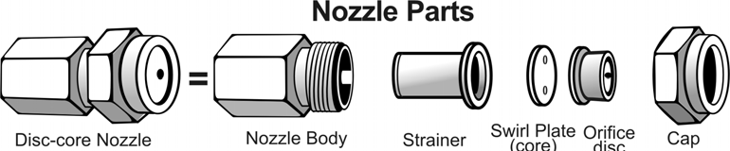
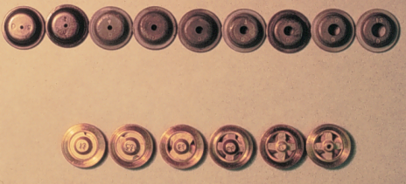
Nozzle Components (Hollow Cone)
Body
Cap
Strainer
Disc (orfice)
Core (whirl plate)
Meter liquid
Size
Atomize (droplet size)
Type (Hollow, Solid Cone or Fan)

Slide 8
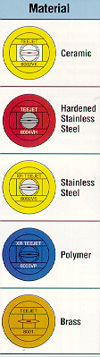
MATERIALS AND WEAR
Percent increase in nozzle flow rate
Flat-fan spray nozzles after 40 hour test

Slide 9
Preparing the Sprayer
Thoroughly clean all nozzles and screens to ensure proper operation.
Check all nozzles to see that they are the desired make and model.
Make sure that all spray patterns are uniform from each nozzle. Replace nozzles that do not have uniform spray patterns.
Be sure that all nozzles have the same volume of delivery.
Select an operating speed. When spraying, be sure to use the same speed used for calibrating.
Select an operating pressure. Adjust pressure to desired psi while the pump is operating at normal speed.

Slide 10
SPEED
1.5 to 4 miles per hour
Better coverage is obtained at the lower speeds, particularly at wind speeds above 5 miles per hour.
Recommend 3 mph unless otherwise directed on label

Slide 11
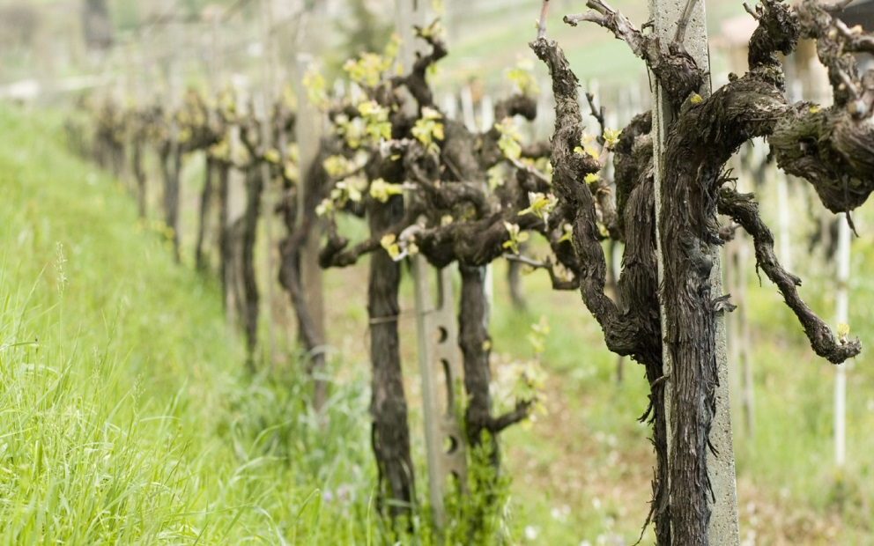
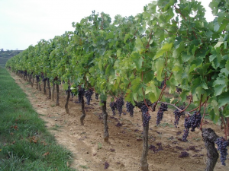
Application Rate
The aim of good pesticide application is to provide many small droplets which will stick to the surface of the leaf. If the volume applied is too great, leaf surface run-off occurs, removing fungicide from the leaves. If the volume is reduced too much, then there aren’t enough droplets to cover the leaves, thus not providing a thorough coverage for disease control.

Slide 12
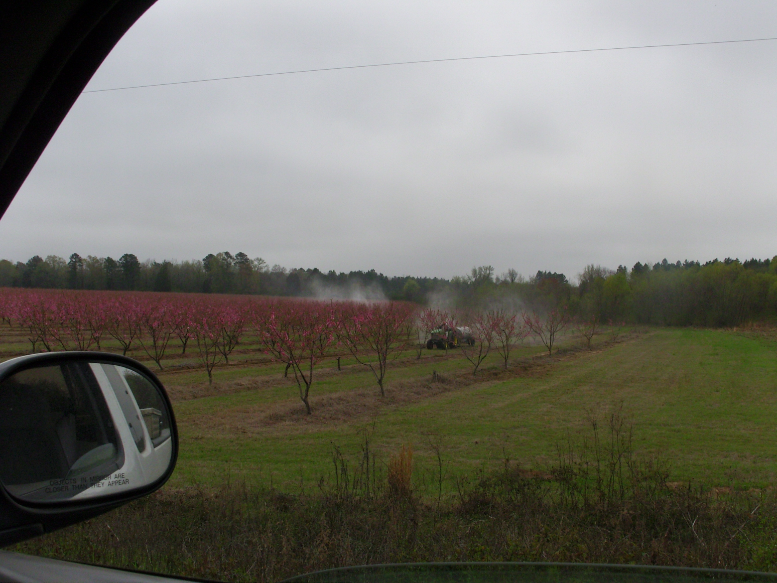
Target spraying

Slide 13
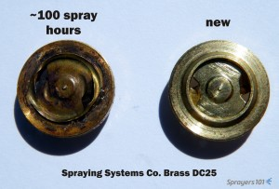
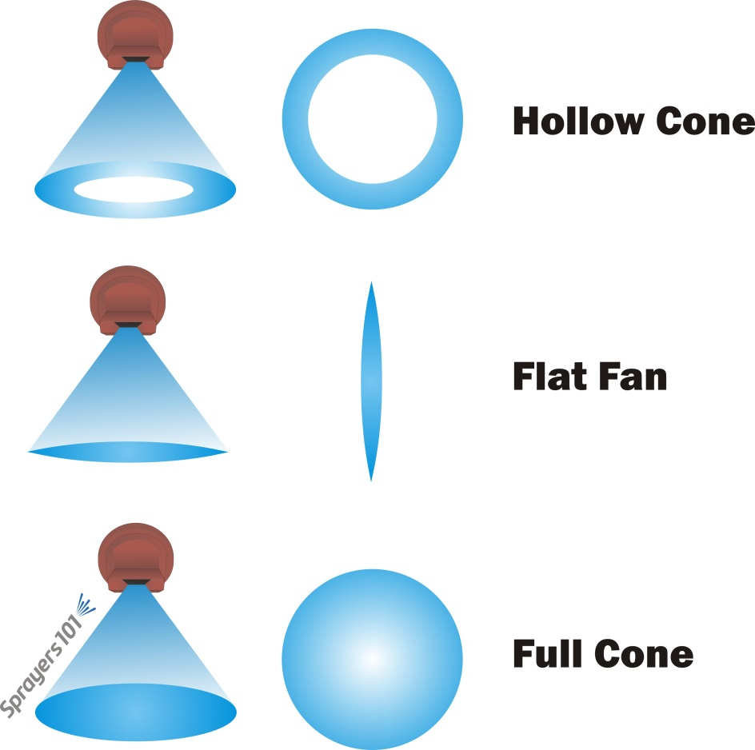

Slide 14
Nozzle Selection Example
Unknowns
GPM – output needed
Nozzles – sizes and placement
Knowns
GPA Desired
Spraying one or both sides of Bush
Number of Nozzles on sprayer
Pressure to run (based on nozzles) (accuracy??)
Speed of Tractor (3 mph) (but how accurate??)
Row Spacing

Slide 15
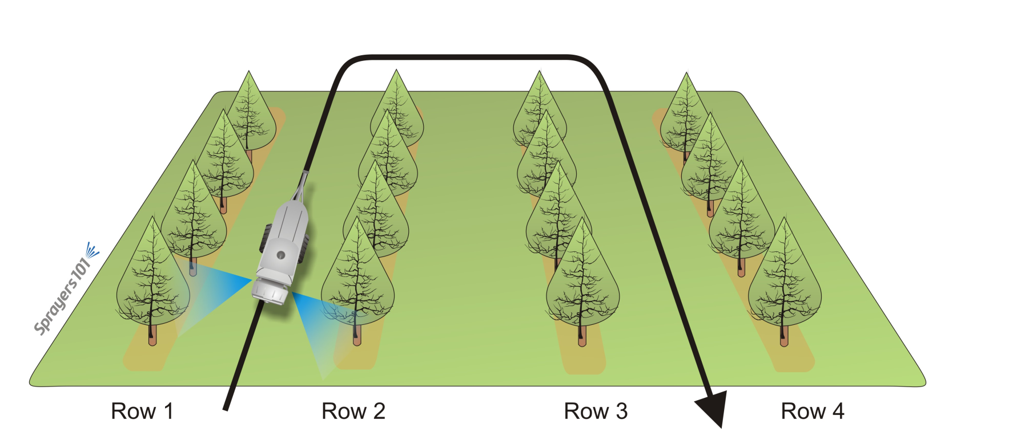
Every row and both sides
What happens to GPA here using above calibration for every row?

Slide 16
AIRBLAST and CANON SPRAYERS
 | Skipped rows | 0 | 1 | 2 | 3
Sides Sprayed |  | Multiply row spacing by:
Both |  | 1 | 2 | 3 | 4
1-side |  | 1/2 | 3/2 | 5/2 | 7/2

Slide 17

 |  | Effective row width multiplication 1
 | Skipped rows | 0 | 1 | 2 | 3
Sides Sprayed
Both |  | 1 | 2 | 3 | 4
1-side |  | 1/2 | 3/2 | 5/2 | 7/2

Slide 18
Effect of Speed on GPA
0.2 mph from desired 3 mph
43-40/40 *100 = +/- 7.5%
0.4 mph from desired 3 mph
+/-15%

Slide 19
Example: Known
GPA = 50
PSI = 150 at the manifold
MPH = 3.0 (selected travel speed)
Number of nozzles = 10 @ 5 per side
Row spacing = 12 feet

Slide 20
Calculate per Nozzle
GPM per nozzle = GPM/(# of nozzles)
Check Chart to get nozzle sizes that produce the amount of flow per nozzle
Get amounts in the part of the grape vine you need it

Slide 21
Unknowns
Gallons per minute output needed
Total both sides
1.8 gpm/side

Slide 22
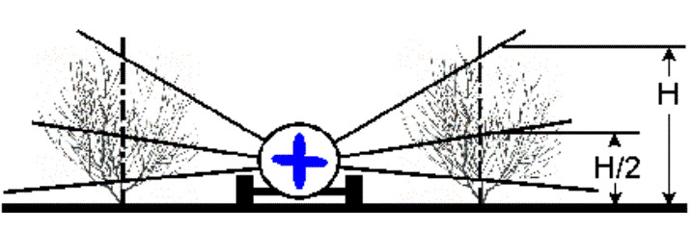
SPRAY VOLUME
²/₃ to ³/₄ of the spray to the top half of bushes
¹/₃ to ¹/₄ to the bottom half

Slide 23
²/₃ x 1.8 gpm = 1.2 gpm
¾ x 1.8 gpm = 1.35 gpm
1/5 x 1.8 gpm = 0.36 gpm
Therefore upper half nozzles 1.2 to 1.35 gpm
Lower half nozzles 0.45 to 0.6 gpm

Slide 24
D3-25 disk = (5 x 0.35) = 1.75
1.75 GPM/side

Slide 25
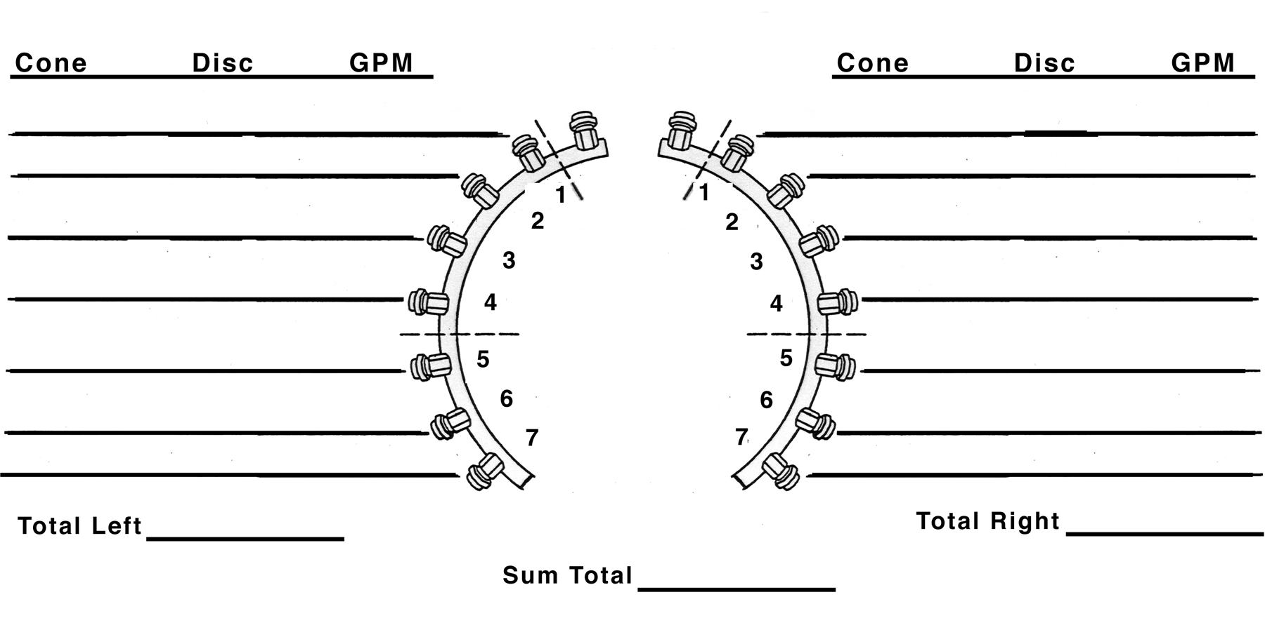
Core
Core
D3 25 .35
D3 25 .35
D3 25 .35
D3 25 .35
D3 25 .35
D3 25 .35
D3 25 .35
D3 25 .35
D3 25 .35
D3 25 .35
1.75
1.75
3.50

Slide 26
D3-23 disk = (2 x 0.21) = 0.42 GPM
D3-25 disk = (1 x 0.36) = 0.36
D4-25 disk = (2 x 0.54) = 1.08 GPM
1.86 GPM/side

Slide 27
D3-23 disk = (2 x 0.21) = 0.42 GPM
D3-25 disk = (1 x 0.36) = 0.36
D4-25 disk = (2 x 0.54) = 1.08 GPM
1.86 GPM/side
D3-23 nozzles = (1 x 0.21) = 0.21 GPM
D4-25 nozzle = (2 x 0.54) = 1.08 GPM 1.29 GPM or 69%

Slide 28
Core
Core
D3 23 .21
D3 23 .21
D4 25 .54
D4 25 .54
D4 25 .54
D4 25 .54
D3 25 .36
D3 25 .36
D3 23 .21
D3 23 .21
1.86
1.86
3.72

Slide 29
What is GPA now??
GPA = 3.72*495 / (3 * 12)
GPA = 51.1 GPA
GPA = 3.5*495/(3*12)
GPA = 48.125

Slide 30
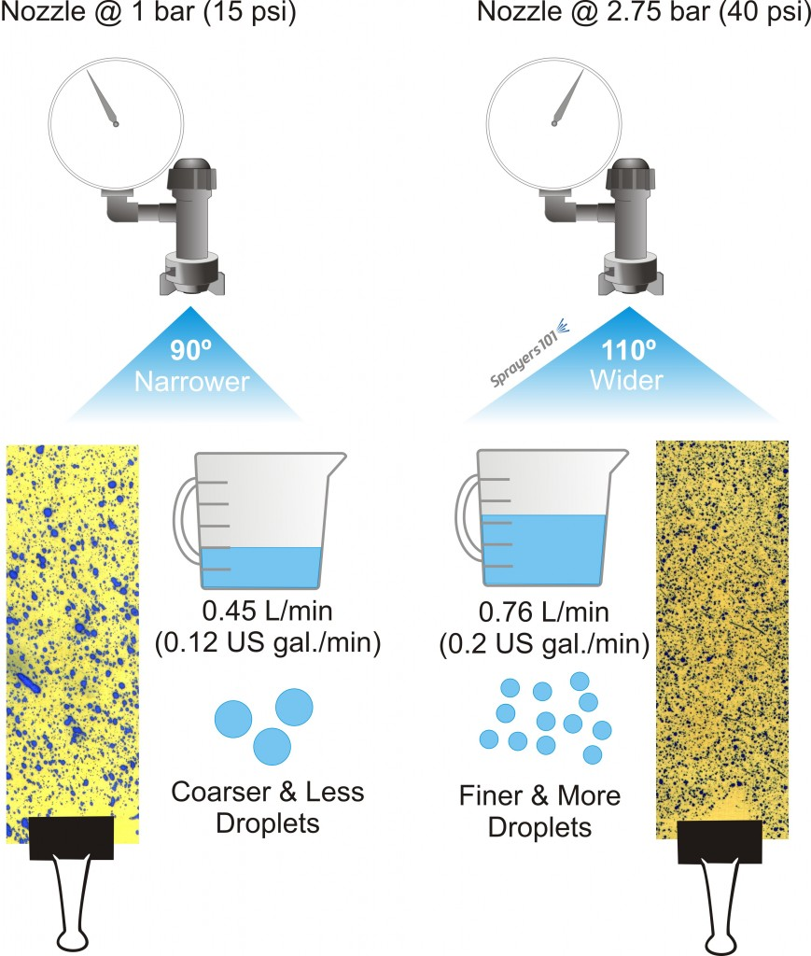

Slide 31
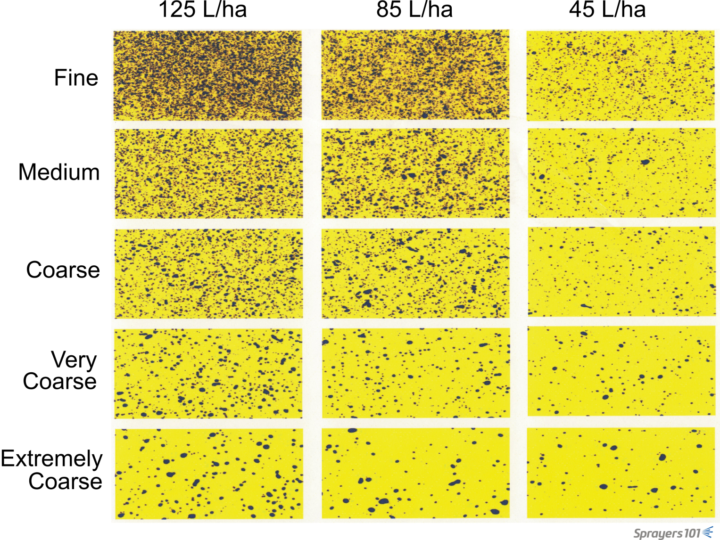

Slide 32
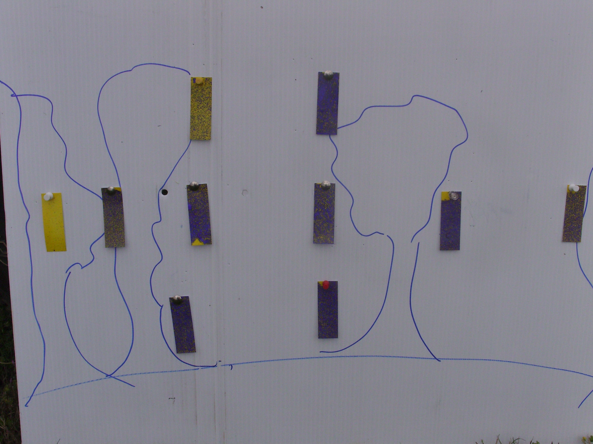
Peach tree and air blast sprayer Early Season

Slide 33
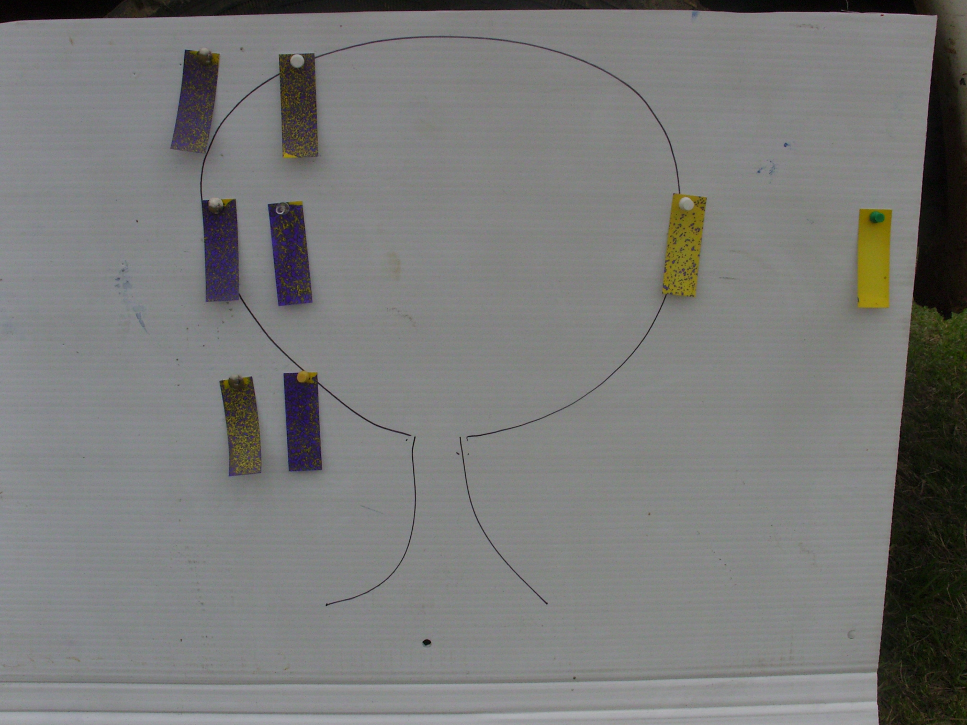

Slide 34
AIR BLAST SPRAYER CALIBRATION
Determine Ground Speed

Slide 35
To check actual output:
Fill sprayer with water. Note the level of fill.
Operate the sprayer at the pressure that will be used during application for a measured length of time. A time period of several minutes will increase accuracy over a time period of 1 minute.

Slide 36
To check actual output:
3. Measure the gallons of liquid required to refill sprayer to the same level it was prior to the timed spray trial with the sprayer in the same position as when it was filled initially. The actual GPM can be calculated as follows:

Slide 37
To check actual output:
4. Calculate the GPA being applied by the sprayer.

Slide 38
3 Choices to adjust sprayer GPA
Small Changes in GPA
Increase pressure to increase output
Decrease pressure to decrease
Larger Changes in GPA
Reduce speed to increase GPA
Increase speed to increase GPA
Best alternative
Select new nozzle combinations

