Slide 1

Joseph A. Fiola, Ph.D.
Specialist in Viticulture and Small Fruit
Western MD Research & Education Center
18330 Keedysville Road
Keedysville, MD 21756-1104
301-432-2767 ext. 344; Fax 301-432-4089
jfiola@umd.edu
http://extension.umd.edu/smallfruit

Slide 2
Recommended and Promising (?)
Winegrape Cultivars
for the Eastern US
Joseph A. Fiola, Ph.D.
Specialist in Viticulture and Small Fruit
University of Maryland Extension

Slide 3
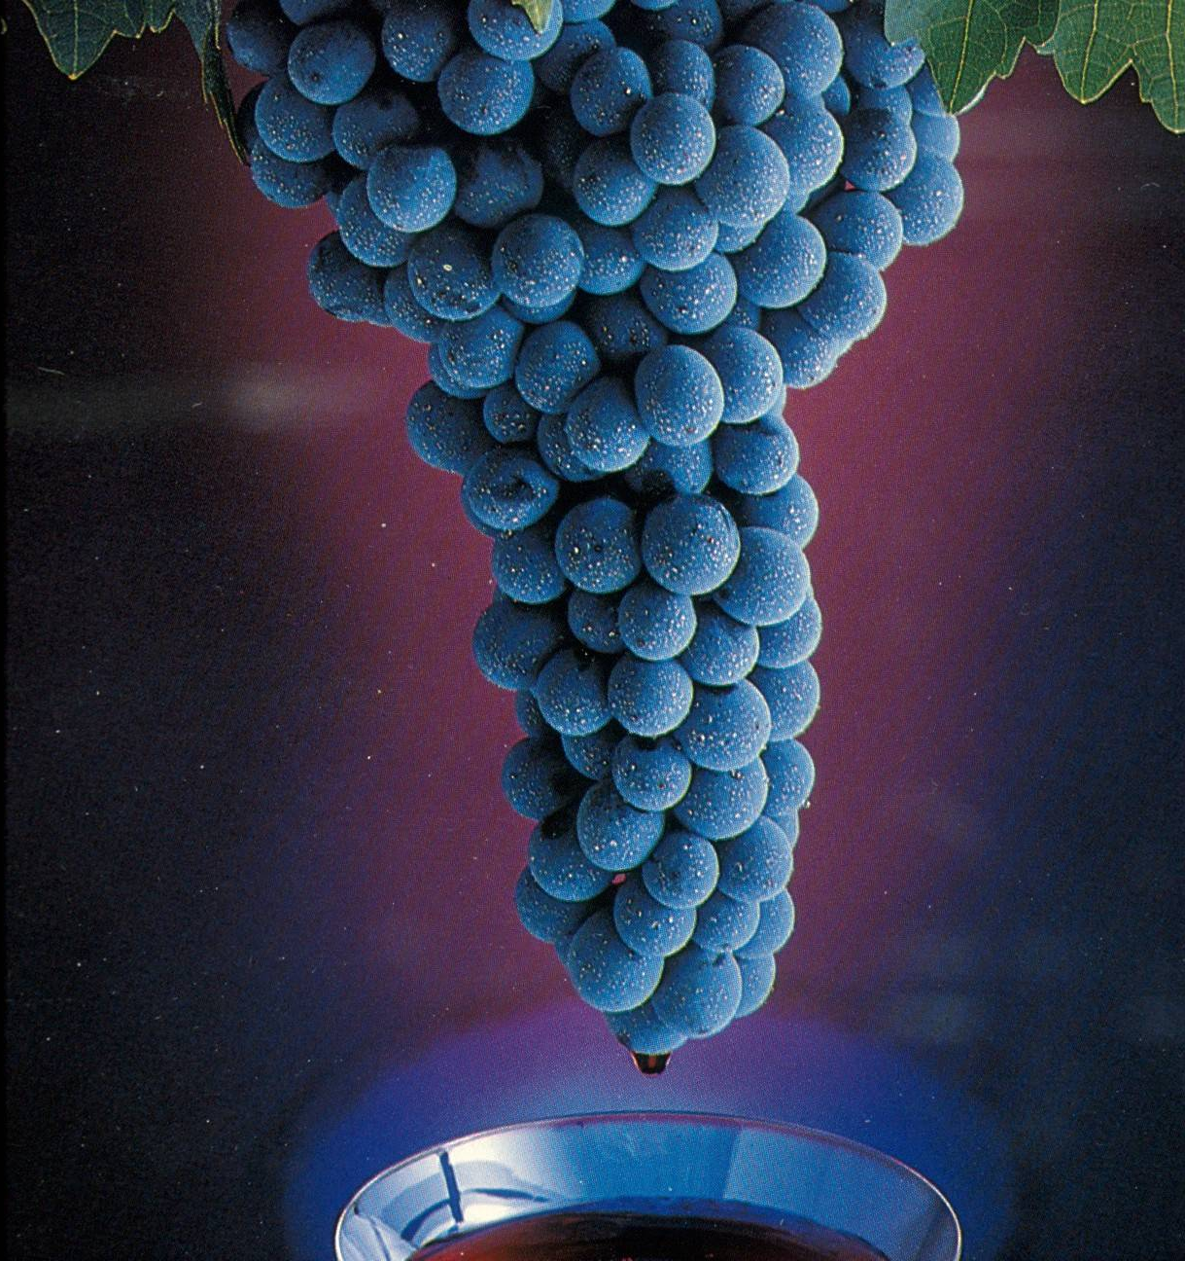
The Wine is Made in the Vineyard!

Slide 4
General considerations
Climate/Cultivar interaction critical
Consistent production at your site
Consistently high quality at your site
  Cold Hardiness
  Disease and pest pressure
  Warm days/Cool nights during ripening
  Ripe all or majority years!!
Demand by existing wineries
Demand by consuming public (winery)
Crop value consistently exceeds cost of production

Slide 5
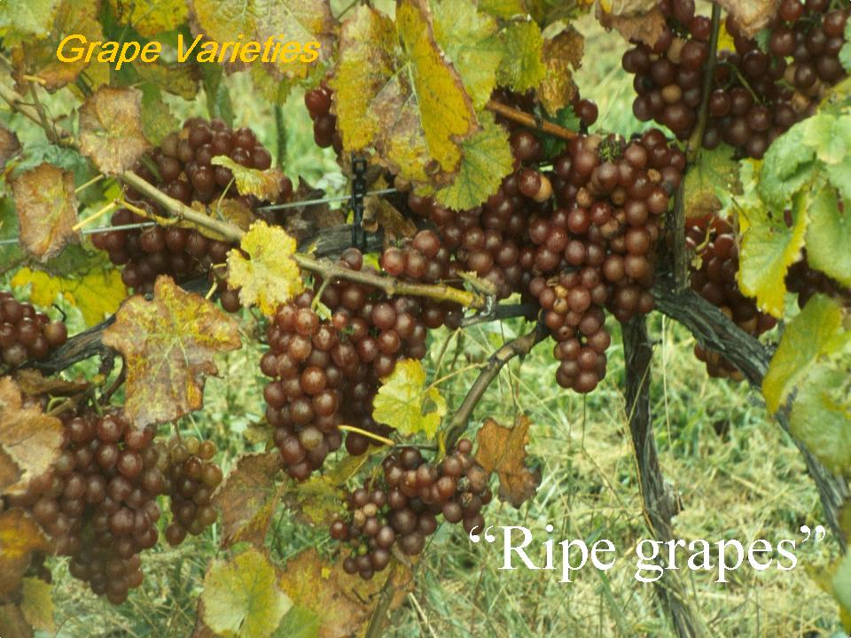
Grape Varieties
Consistent production of
fully and uniformly ripened
grapes
“Ripe grapes”

Slide 6
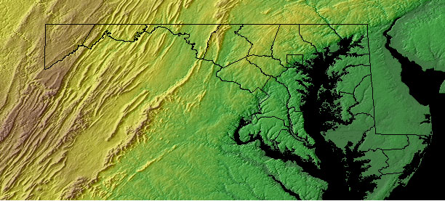
UME R&D Vineyard Locations
WMREC - Keedysville
“Golden Run Vineyard”
– Sudlersville
CMREC – Upper Marlboro
WyeREC - Queenstown
Zones 6b to 8a
3000-3800 GGD
“Summerseat” – Lusby
LESREC - Salisbury
Regional cultivar performance testing

Slide 7
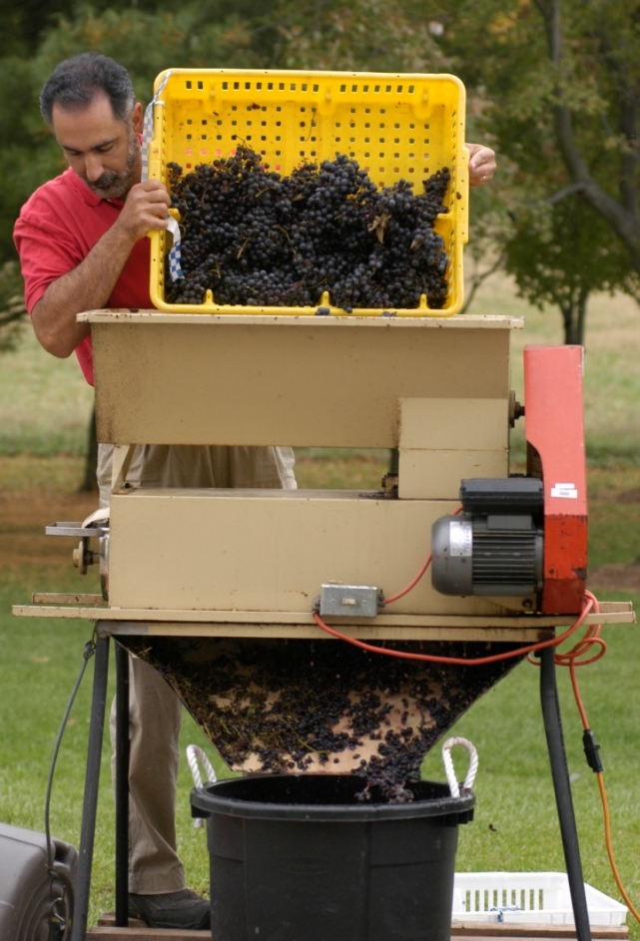
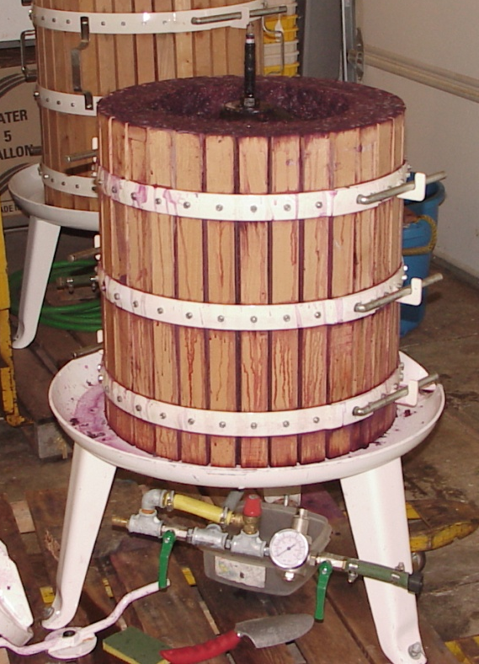
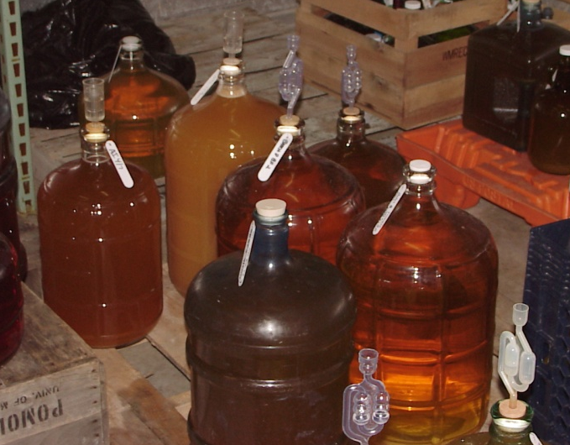

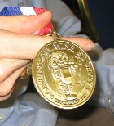
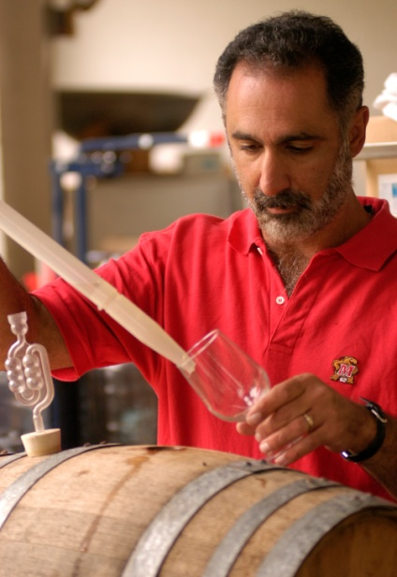
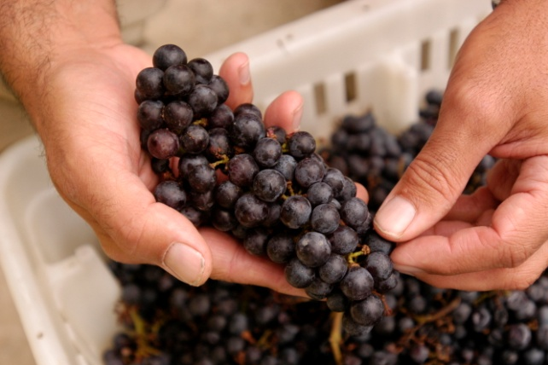
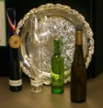
Enology (Winemaking) R&D
A demonstration winemaker (not an Enologist!); Wine is DATA!

Slide 8
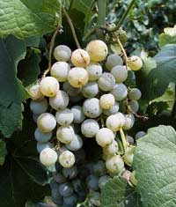
‘Cayuga White’
(hybrid)
Strengths:
  Very good cold hardiness
  Very high yields
  Excellent disease resistance
  Versatile
Weaknesses:
  Over-cropping
  Labrusca character when ripe
  Name!

Slide 9
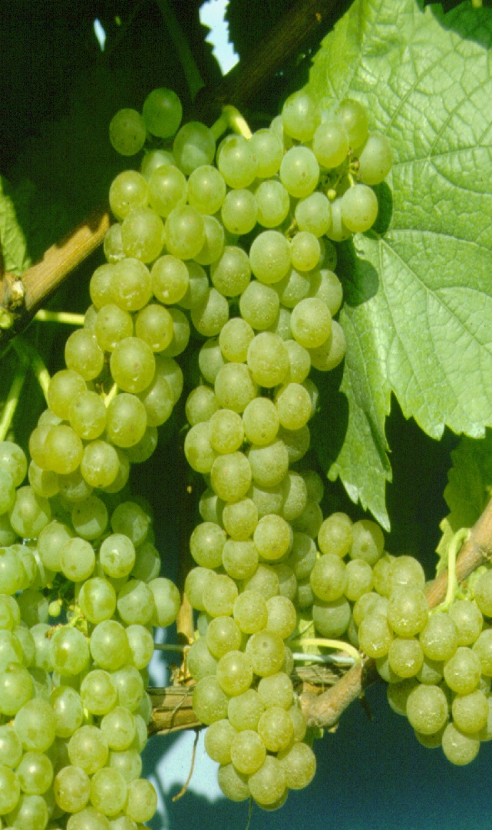
‘Vidal Blanc’
(hybrid)
Strengths:
  Good cold hardiness
  High yields
  Versatile – work horse
  Late bud break
  Good bunch rot resistance
Weaknesses:
  Over cropping
  Susceptible to Downy Mildew
  Susceptible to tomato & tobacco ringspot viruses
    Must graft to rootstock

Slide 10
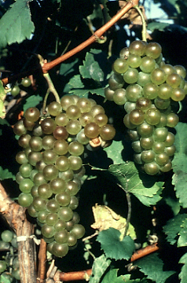
‘Chardonel’
(‘Seyval Blanc’ x ‘Chardonnay hybrid’)
Strengths:
  Good cold hardiness
  Good heat tolerance
  Good disease resistance - DM!
  Mid-season (9/15 Wye)
Weaknesses:
  Consistent cropping (2-5 T/A)
  Limited local testing
  Phylloxera susceptible - graft
Wine:
  Pome fruits
  Thin body?/good for BF

Slide 11
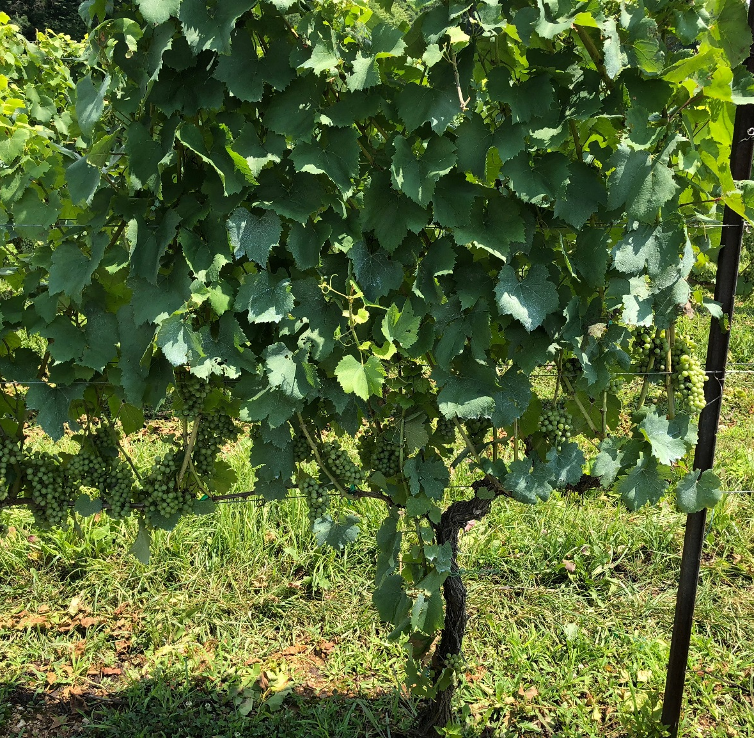
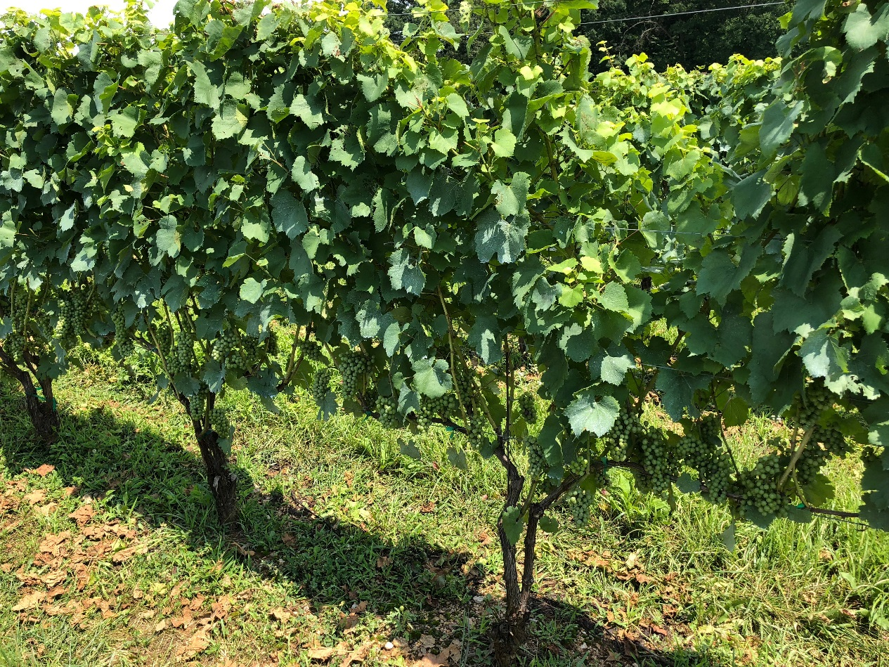
‘Chardonel’ Plot at WREC
Good performance in very wet 2018!

Slide 12
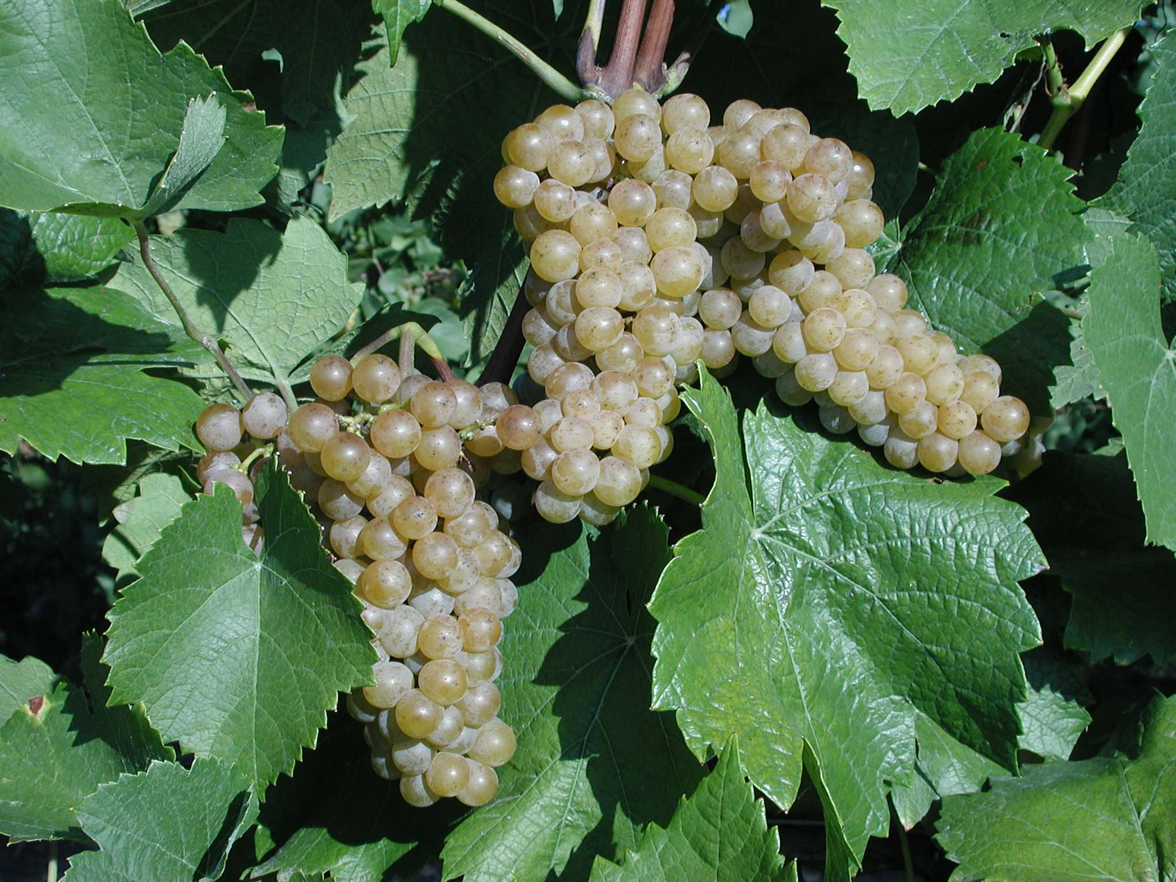
‘Traminette’
(‘Gewürztraminer’ hybrid)
Strengths:
  Good yields
  Excellent fruit quality
  Good cold hardiness
  Good disease resistance
  High demand
Weaknesses:
  Vigor
  Predation!

Slide 13
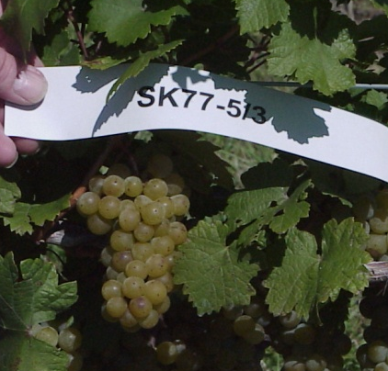
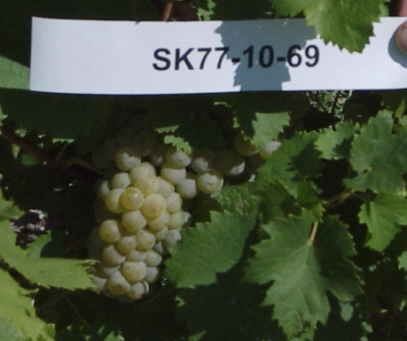
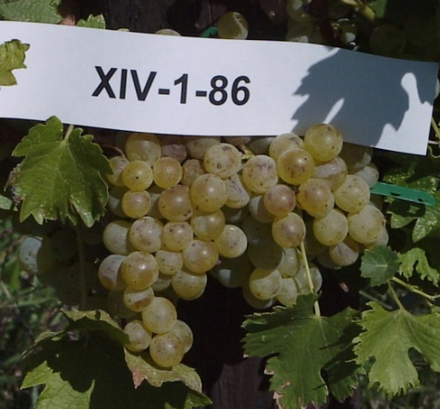
Hardy EU/SU Varieties
Hungary, Bulgaria, Georgia, Uzbekistan
“Three way” hybrids (with V. amurensis)
Strengths:
  Excellent cold hardiness
  Good disease resistance
    V. amurensis hybrids
  Good wine quality
    Aromatic
    Germanic/Muscat
    Great mouth feel
  Quality in heat
    WyeREC
Weaknesses:
  Limited commercial experience
  Names/numbers

Slide 14
SK77-5-3 (‘Petra’)
EU Hybrid (‘Kunbarat’ x ‘Pinot Noir’)
“Three way” hybrids (with V. amurensis)
Strengths:
  Excellent cold hardiness
  Good disease resistance - DM
  High Productivity
  Quality in heat
    WyeREC
Weaknesses:
  Early bud-break
  Availability
  Names/numbers
Wine:
  Aromatic – Germanic/Tropical/Muscat
  Great mouth feel

Slide 15
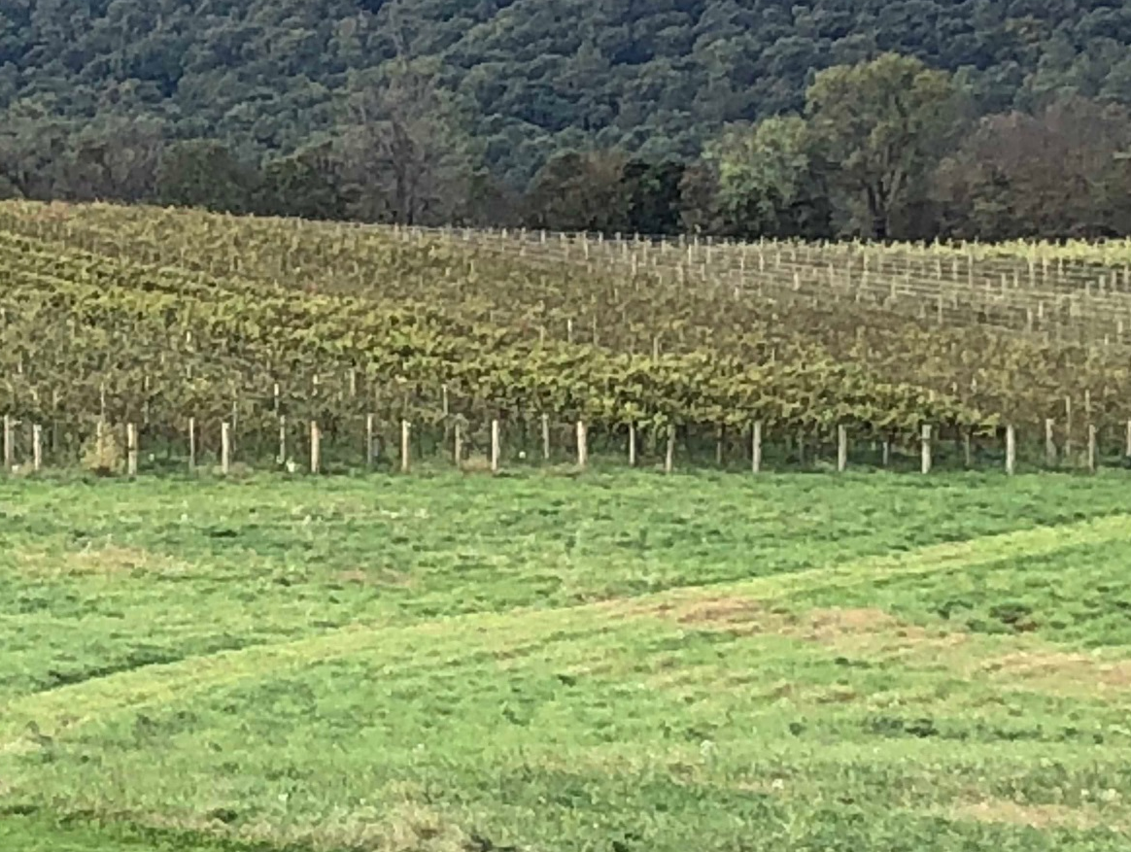
Hardy EU Varieties
SK77-5-3
Strong
Downy
Mildew
Resistance

Slide 16
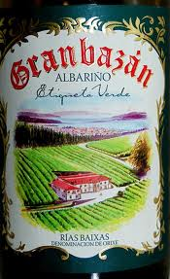
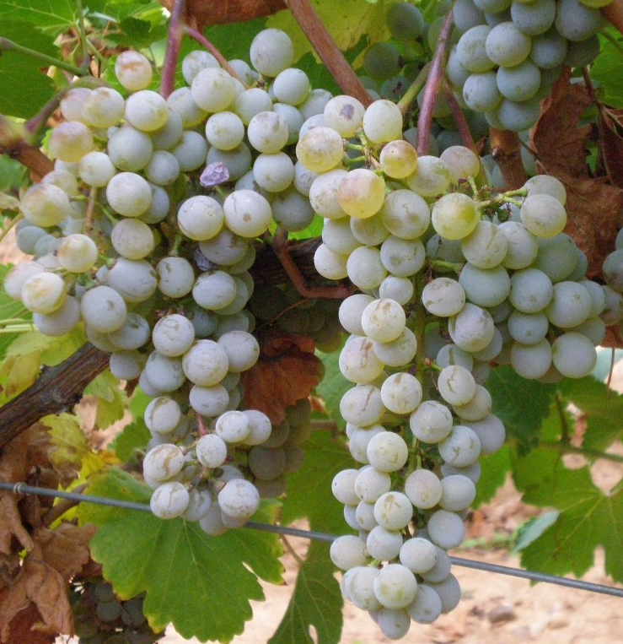
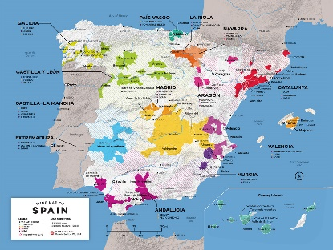
‘Albariño’
(vinifera – Spain/Galacia)
Characteristics:
Small loose clusters
Small, teardrop (slight) shaped
Mid season white (9/19/13)
Slightly light? but consistent crop
  Clone differences? C1, C2
Good for disease – less DM?
Wine:
  Holds acid
  Peach/aromatic
  Mineral/Dryc

Slide 17
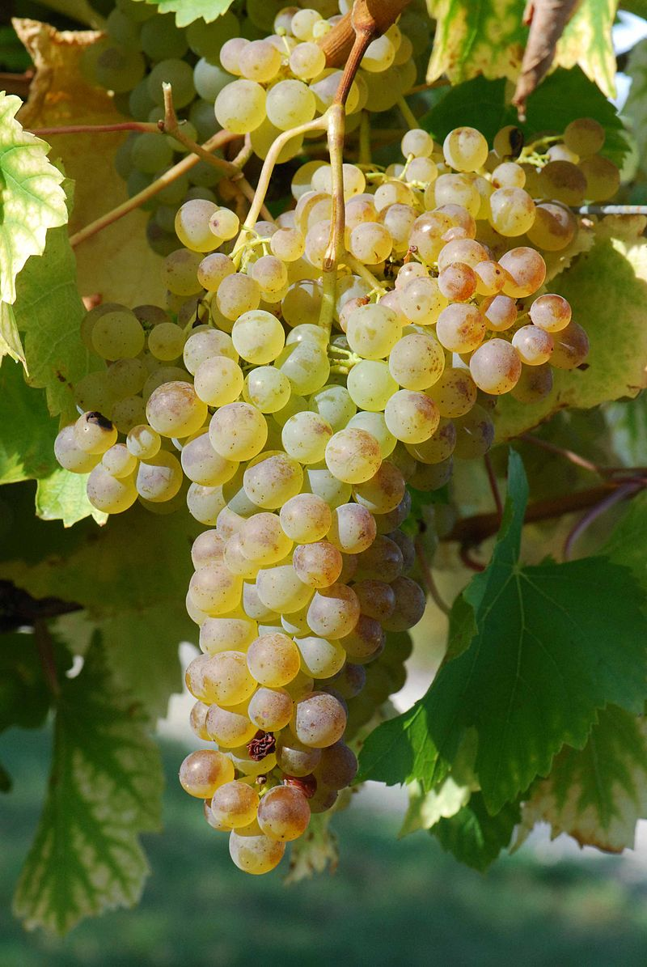
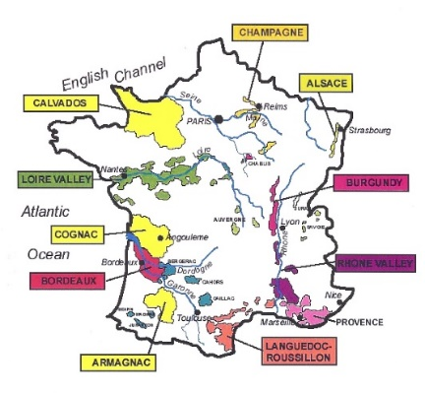
‘Colombard’ ‘Coulombier’
(vinifera – Charentes, Bordeaux, France)
Strengths:
  Hardiness
  Consistent, high yields (3-8 T/A!)
  Medium ripening
  Name recognition
  Heat tolerance/acid
Weaknesses:
  Thinning needed
  Limited testing
    History in California
Wine
  Aromatic, tropical; citrus
  Structure, round, full bodied

Slide 18
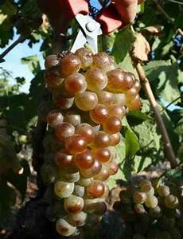
‘Rousanne’
(vinifera – Rhone, France)
Strengths:
  Good Hardiness
  Very good yields (3-6 T/A)
  Medium ripening
  Aromatic
Weaknesses:
  Name recognition
  Limited testing
Wine
  Aromatic; citrus
  Structure, weight, rustic
  Complex; good food wine

Slide 19
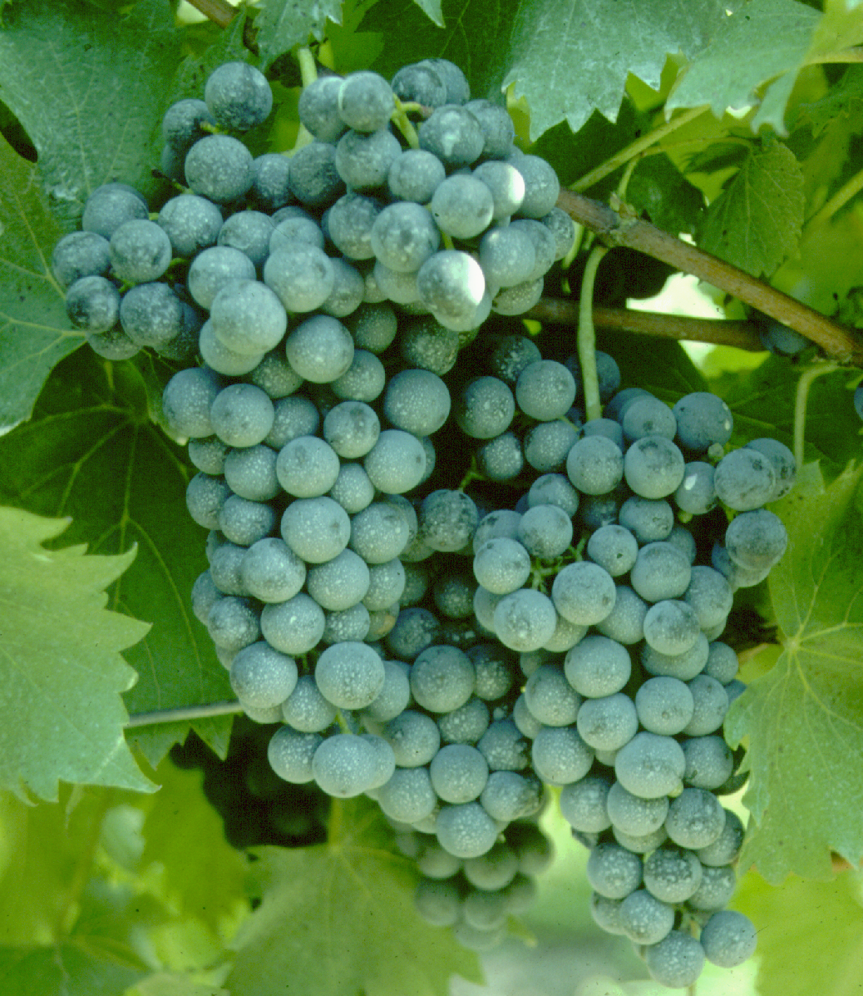
‘Chambourcin’
(hybrid)
Strengths:
  High quality
    versatile
  Good cold hardiness
  Disease resistant
Weaknesses:
  Late ripening
  Name

Slide 20
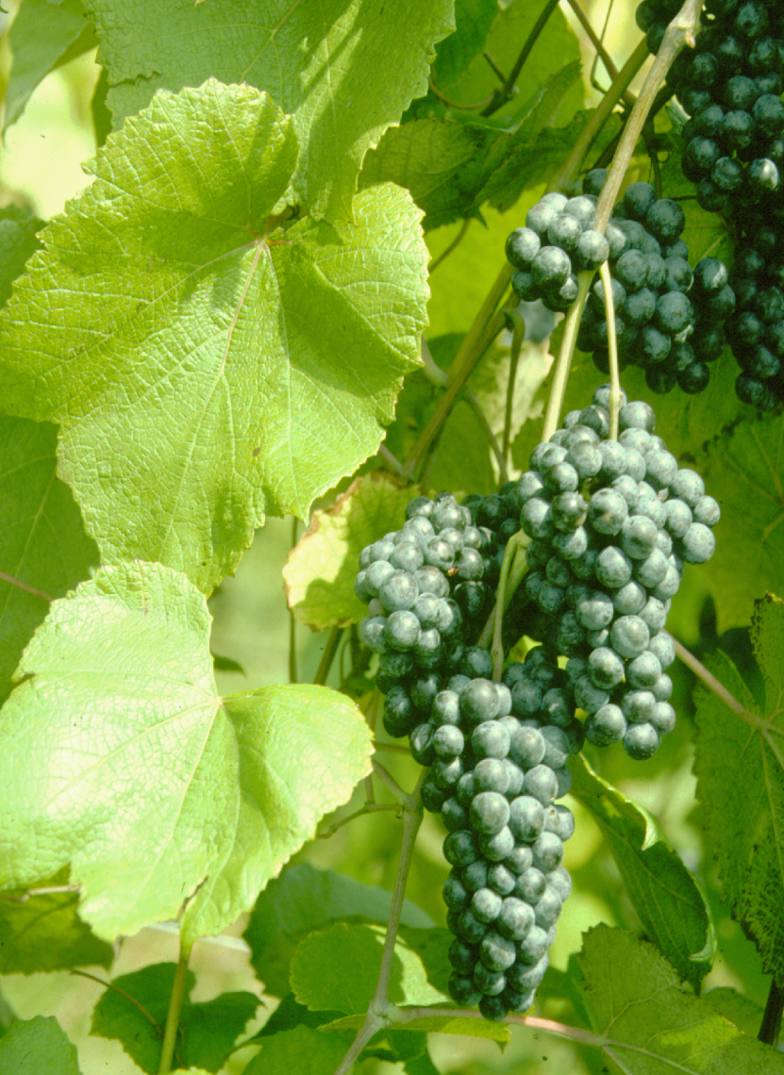
‘Norton’/‘Cynthiana’
(red V.aestivalis (American spp.)
Strengths:
  Cold hardy
  Good disease resistance
  2X NJ GC winner
  Increasing local interest
  Very fruity character - blend
Weaknesses:
  Low yields
  Uncertain demand
  High pH and high TA
  Training system?

Slide 21
‘Regent’
(‘Diana (Silvaner x Müller-Thurgau) x Chambourcin)
Strengths:
  High quality
    Versatile
  Good cold hardiness
  Disease resistant
  Certified stock available
  High color; good tannins
  Not S sensitive
Weaknesses:
  “New”
  Late ripening

Slide 22
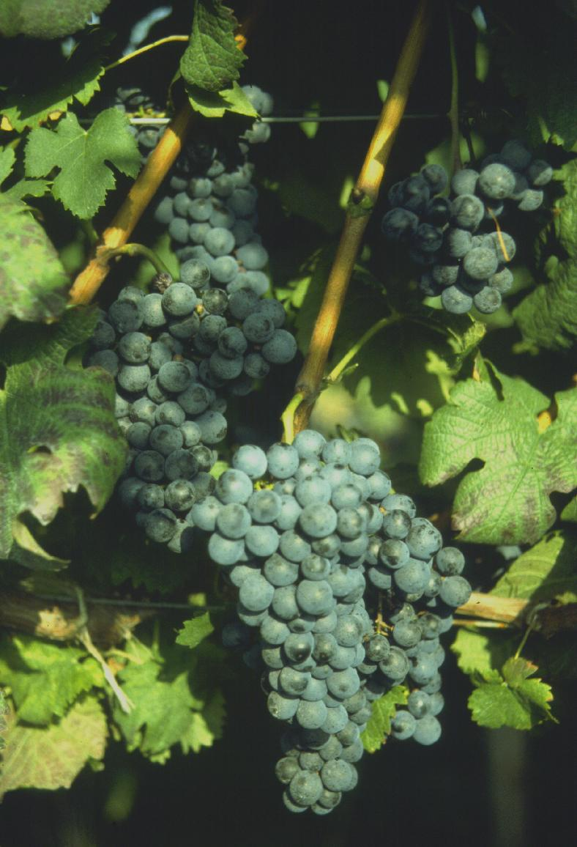
‘Cabernet Franc’
(vinifera)
Strengths:
  Good demand/value/quality
  Good rot resistance
  Cold hardiness > Cab Sauvignon
  Clones #1 and #214
  Ripens earlier that CS
  Later ripening
Weaknesses:
  Occasionally poor fruit set
  High incidence of Leaf roll virus
  Herbaceous when under ripe

Slide 23
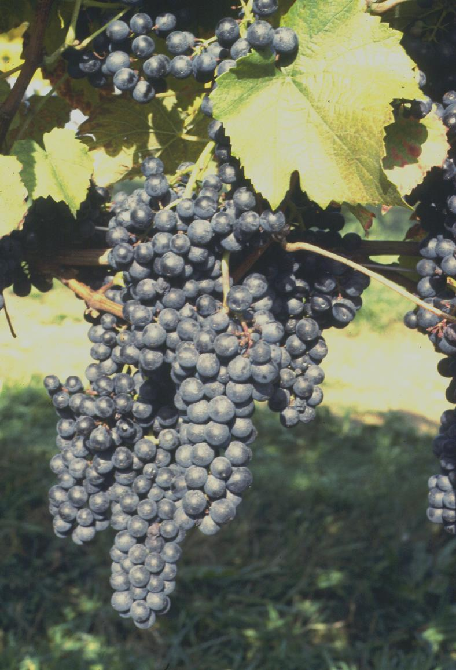
‘Petit Verdot’
(vinifera)
Strengths:
  High yields (at Winchester)
  Good for blending
    Color, intensity
  Greater cold hardiness than Cabernet Sauvignon?
  Ripens with Cabernet Franc (or later?)
  High quality fruit, little rot
Weaknesses:
  High acid and pH in some years
  Susceptible to Phomopsis?
  Demand rising

Slide 24
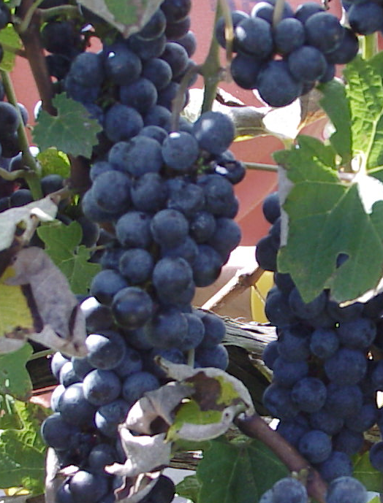
‘Merlot’
(red vinifera)
Strengths:
  High demand
  Consumer recognition
  Excellent fruit/wine quality
  Ripens early
Weaknesses:
  Cold tender?
  Susceptible to bunch rot
Only best sites in North!

Slide 25
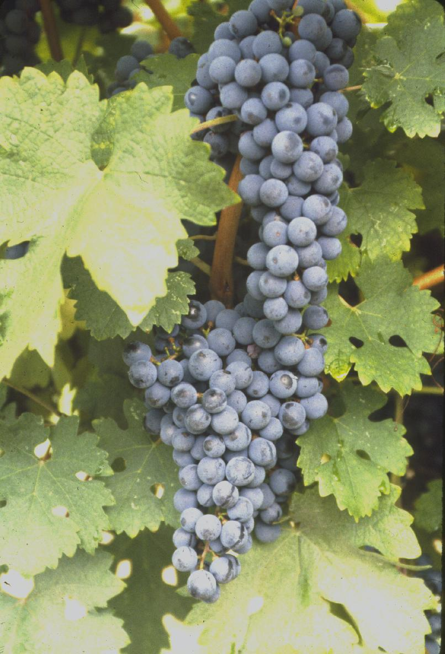
‘Cabernet Sauvignon’
(Bordeaux - vinifera)
Strengths:
  High demand
  Yields?
  Late bud break
  Good rot resistance
Weaknesses:
  Variable ripening
    Consistent ripening each year
  Cold-tender - establishment
  Bunch stem necrosis
  Only best sites!!!!!

Slide 26
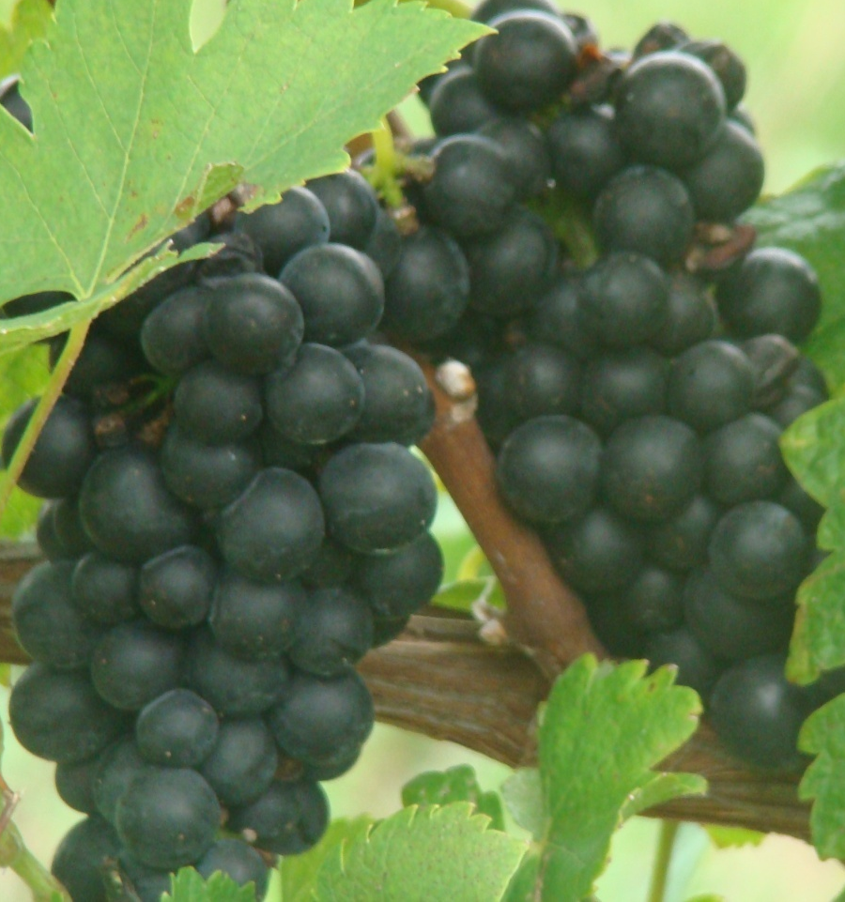
‘Lemberger’
(Austria, red vinifera ‘Blaufrankish’)
Strengths:
  Good cold hardiness (=CabFranc?)
  Mid harvest (9/17/2019)
    < CabFranc at WMREC
  Good color – manage crop
  Good cluster disease resistance
Weaknesses:
  Name!
  High yields – but inconsistent/variable
    needs management! (3-6 TA)
    Color crop sensitive
  Prefers cooler sites?

Slide 27
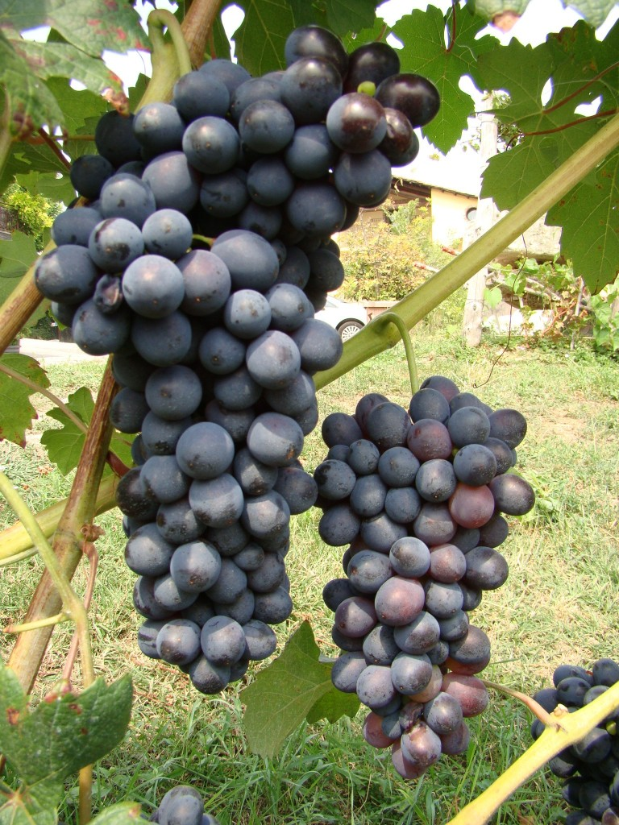
‘Barbera’
(Italy - vinifera)
Strengths:
  High yields – needs management
  Greater cold hardiness than CabSauv?
  Ripens with Cab Franc
  High quality fruit, little rot
  Good quality wine
    Color, softness
  Clones – too early
Weaknesses:
  High yields – needs management
  Dis-synchronous ripening
  High acid
  Demand uncertain

Slide 28
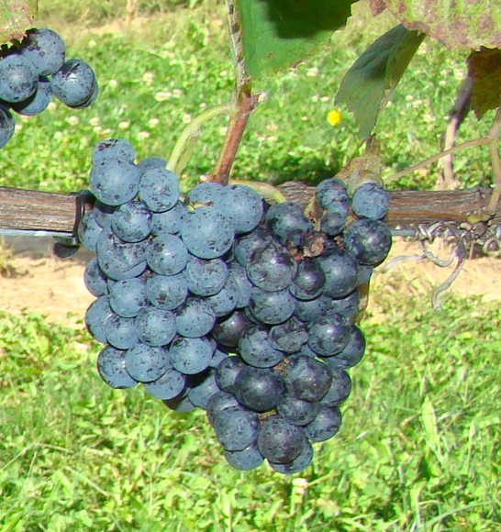
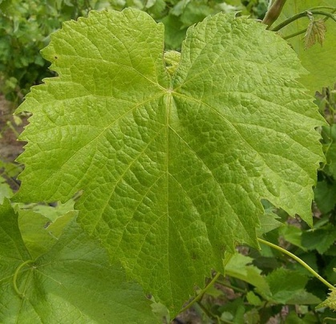
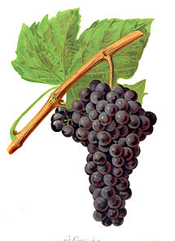
‘Souzao’ (suh ZAH)
(vinifera – Portugal) - (Main grape in Port)
Characteristics:
Med berries – Small loose clusters
Medium/consistent balanced crop
Early season (9/26/13 GRV; 9/10/19)
Good for disease – less DM?
Deep color; Ripe dark fruit flavors
Wine:
  Hold acid well (20; 3.36 pH)
  Big/Ripe berries/Soft tannin
  Great food wine due to acidity

Slide 29
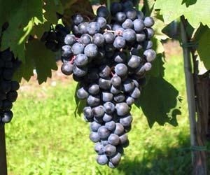
‘Tempranillo’
(vinifera – Tinto Roriz; Spain/Rioja/Ribera)
Characteristics:
Medium round berries – medium clusters
Consistent crop
Mid season red (9/10)
Some DM
Deep color;
Wine:
  Soft, Complex
  Ripe dark fruit flavors
  Medium bodied/soft tannin

Slide 30
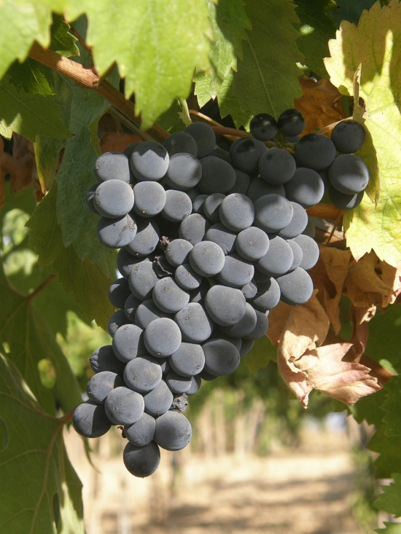
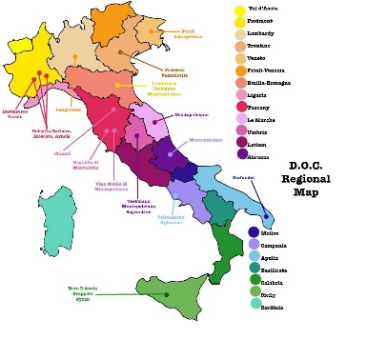
‘Montepulciano’
(vinifera – Italy/Abruzzo/Molise/Marche)
Characteristics:
Medium round berries
  medium clusters
Consistent crop
Mid season red (9/19/2019)
Some DM
Deep color;
Wine:
  Complex
  Ripe dark fruit flavors
  Full bodied/Ripe/soft tannin

Slide 31
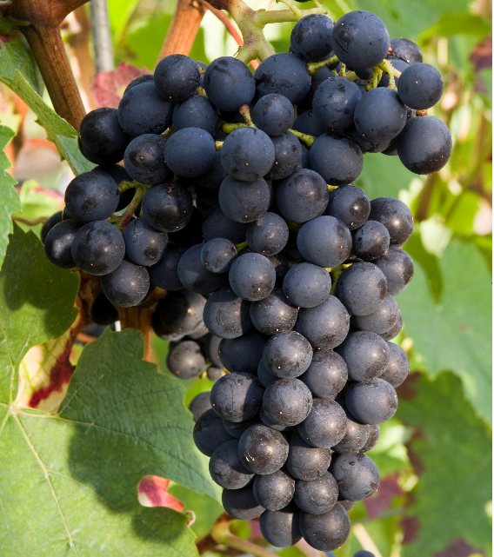
‘Gamaret’
(vinifera – Switzerland - Gamay Noir x Reichensteiner)
Strengths:
  Early-ripening (9/5/2019)
  High quality fruit
  Resistant to LSR
Weaknesses:
  Consumer recognition
  Vine availability
  Limited testing
  Hardiness?
Wine
  Dark color
  Medium bodied - fruity

Slide 32
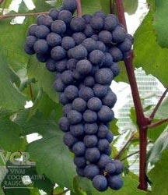
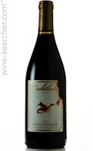
‘Teroldego’
(vinifera – Italy/Trentino-Alto-Adige)
(Parent = ‘Dureza’ also a parent of ‘Syrah’)
Characteristics:
Big round berries – big clusters
Good consistent crop
Mid-late season red (9/26/13)
Good for disease – less DM?
Deep color; Ripe dark fruit flavors
Wine:
  Hold acid well (21; 3.7 pH)
  Big/Ripe/Spicy/Big soft tannin
  Great food wine due to acidity

Slide 33
White Varieties in Trial
Albariño Petite Manseng XX-11-57
Colombard Verdelho Muscat Ottonel
Pinot Blanc Marsanne 54-36-34
Sauvignon Blanc Ottonel SK77-10-69
SK77-5-3 Feher SK77-12-6
Gruner Veltliner Fernou Valvin Muscat
Roussanne Vernaccia Malvesia Blanc
Vignoles Vermentino Linae
Picpoul Viognier Fiano
Verdejo Arneis 34-4-49
Muscat Blanc Falenghina
XIV-1-86 Viozinho Semillon

Slide 34
Red Cultivars in Trials
Gamay Montepulciano Syrah?
Garanoir Malbec? Pinot Noir?
Gamaret Carmenere? Durif/Petit Sirah
Teroldego Lagrein Pinotage
Barbera Touriga Nebbiolo
Souzao Dolcetto Grenache
Tannat Sagrantino Graciano/Aleatico
Chelois Rofosco Counoise
Regent Schiopitino Negro Amaro
Lemberger Corvina Vespolina
Petit Verdot Kozma 525 Malvesia Negra
Sangiovese? Kozma 55
Tempranillo San Paolo!

Slide 35
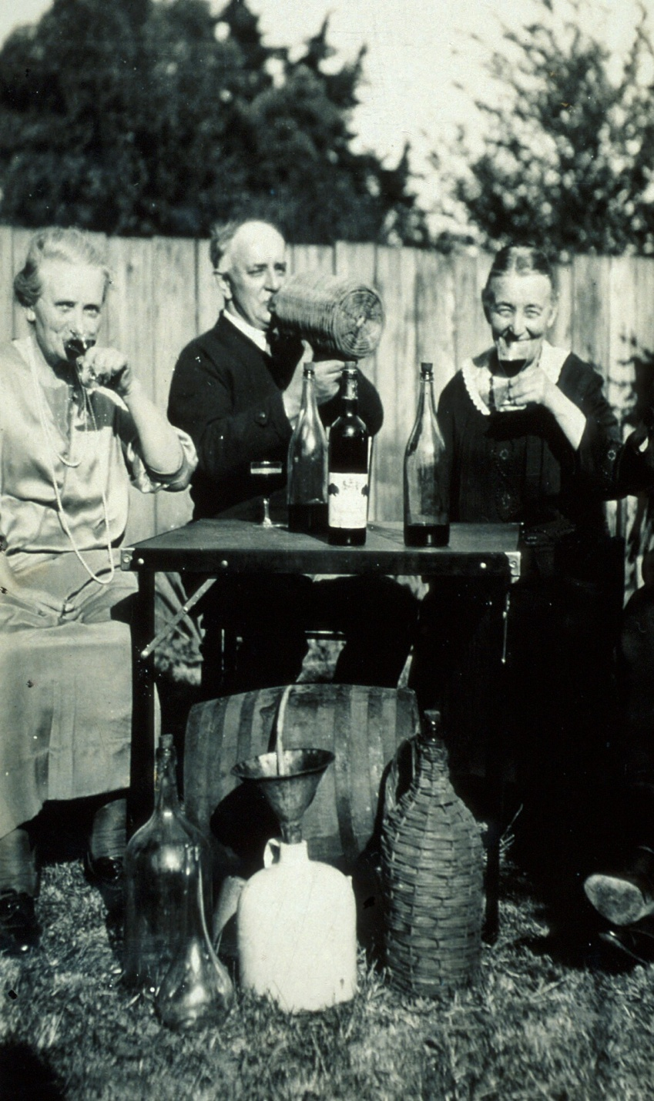
Wine
Marketing:
Know your
clientele

Slide 36

Take an occasional risk!

Slide 37
Contributors
(Thank you!)
Golden Run Vineyard
Sommerseat Vineyard
SCRI Grant USDA CSREES
NE1020 – VC Grants USDA CSREES
Scott labs/Lallemand
Vintage Nursery
UME Impact Team Grants/MAES
Dura-line (Orchard Valley)

Slide 38
““Wine was given by God, not that we might be drunken, but that we might be sober. It is the best medicine when it has moderation to direct it. Wine was given to restore the body’s weakness, not to overturn the soul’s strength.”
St. John Chrysostum
(4th Century preacher)

Slide 39
Joseph A. Fiola, Ph.D.
Specialist in Viticulture and Small Fruit
Western MD Research & Education Center
18330 Keedysville Road
Keedysville, MD 21756-1104
301-432-2767 ext. 344; Fax 301-432-4089
jfiola@umd.edu
http://extension.umd.edu/smallfruit

